Slide 1
Plot1 for model output of the Autoencoder model for Generating Synthetic Data

Slide 2
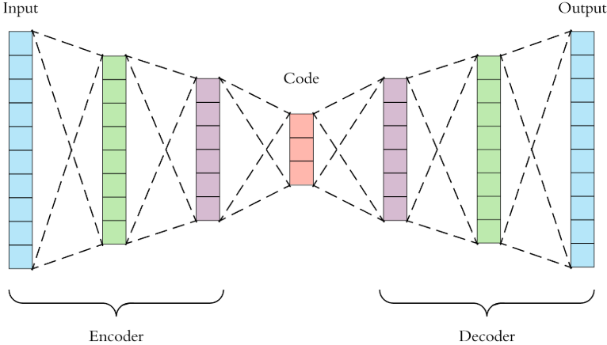
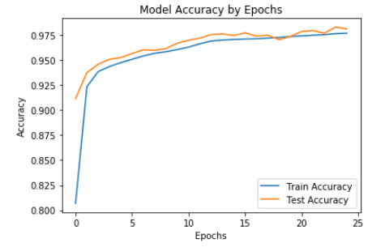
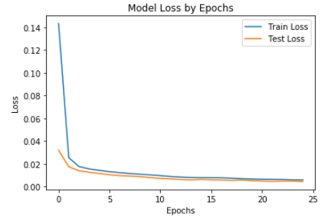
Deep Autoencoder Model Output
Train Accuracy : 98.23 %
Test Accuracy : 98.14 %
Train Loss : 0.0046
Test Loss : 0.0045
There is a minimal difference between both train and test accuracy and loss metrics. We can conclude that model is generalizing.

Slide 3
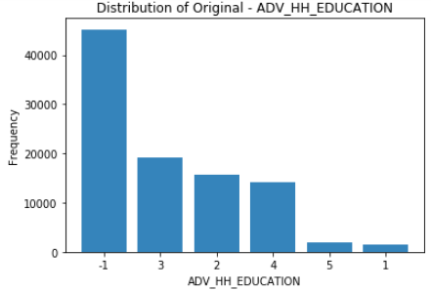
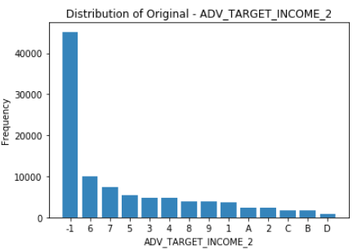
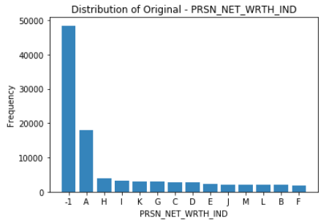
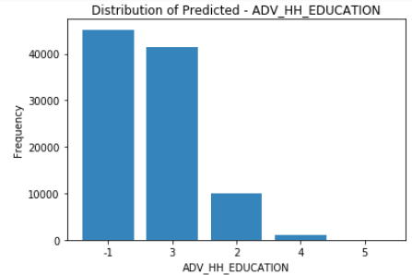
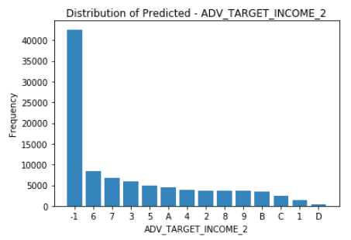
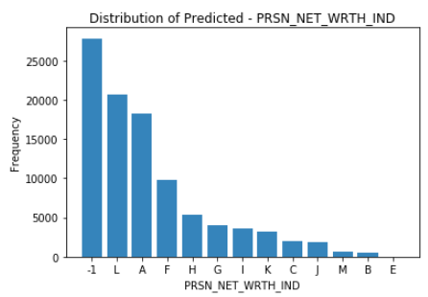
Distribution Check – Actual and Predicted
Education Level
Income Level
Net Worth Indicator
Actual
Predicted

